Slide 1
Alerts/Pop-ups

Slide 2
What are Alerts/popups in Selenium?
Alerts are small popup boxes/windows which display the messages/notifications
To notify the user with some information seeking some permission on certain kinds of operations.
Additionally, we can also use them for warning purposes.
Sometimes, the user can enter a few details in the alert box as well.

Slide 3
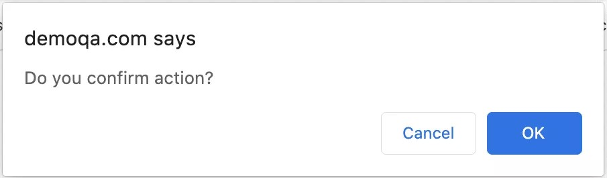
For Example, The alert box displayed below requires an action from the user to press OK and accept or press Cancel and dismiss the message box.

Slide 4
What are the different types of Alerts/popups?
Operating system dependant
Application dependant

Slide 5
Windows/OS Alerts
Window-based alerts are system-generated alerts/popups. The developers invoke the operating system APIs to show these alerts/dialogue-boxes. Handling these alerts in Selenium is a little tricky and beyond the WebDriver’s capabilities, as Selenium is an automation testing tool for web applications only, and we need third party utility to automate window based popups. A few of those utilities are AutoIT and Robot Class in Java.

Slide 6
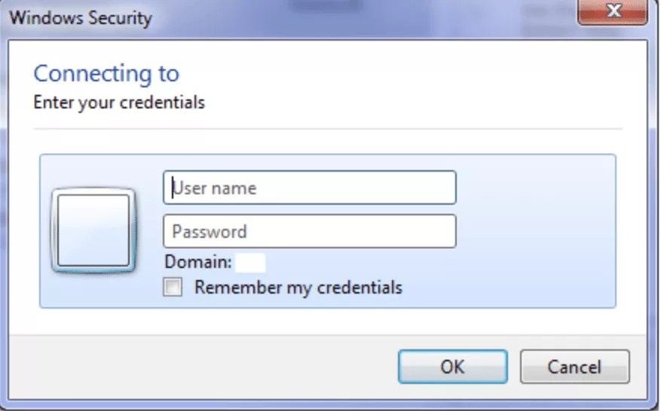
A sample operating system based alert will look as follows and are majorly called Dialog-Boxes

Slide 7
Web/Javascript /Browser-based Alerts
Web/Browser based alerts are primarily called Javascript alerts and are those alerts that are browser dependant. These alerts are majorly called Popups.

Slide 8
What are the various kinds of alerts provided by Web Applications?
Simple Alert
Prompt Alert
Confirmation Alert

Slide 9
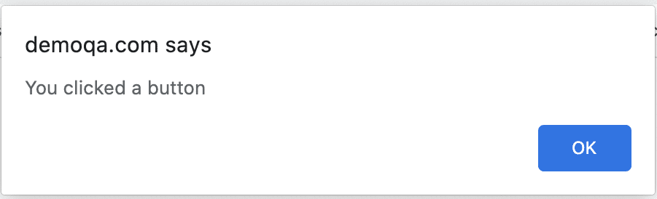
Simple alert
These alerts are just informational alerts and have an OK button on them. Users can click on the OK button after reading the message displayed on the alert box. A simple alert box looks like below:

Slide 10
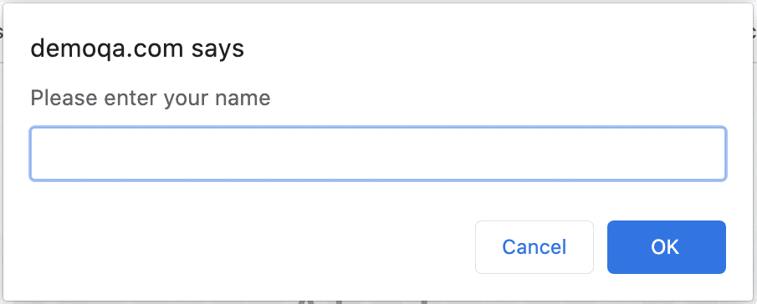
Prompt Alert
In Prompt alerts, some input requirement is there from the user in the form of text needs to enter in the alert box. A prompt alert box is displayed like below, where the user can enter his/her username and press the OK button or Cancel the alert box without entering any details.

Slide 11
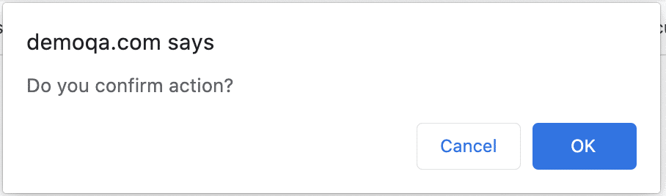
Confirmation Alert
These alerts get some confirmation from the user in the form of accepting or dismissing the message box. They are different from prompt alerts in a way that the user cannot enter anything as there is no text-box available. Users can only read the message and provide the inputs by pressing the OK/Cancel button.

Slide 12
How to handle Alerts/popups using Selenium WebDriver?
The WebDriver always has the focus on the main browser window and will run all the commands on the main browser window only.
To switch the control from the parent window to the Alert window, the Selenium WebDriver provides the following command:
driver.switchTo( ).alert( )
Once we switch the control from the main browser window to the alert window, we can use the methods provided by Alert Interface to perform various required actions

Slide 13
Void accept(): This method clicks on the ‘OK’ button of the alert box.
driver.switchTo().alert().accept();
Void dismiss(): We use this method when the ‘Cancel’ button clicks in the alert box.
driver.switchTo().alert().dismiss();
Note: Apart from these two sendkeys() and getText() also we can use

Slide 14
How to handle unexpected Alerts using Selenium WebDriver?
We have to handle these unexpected alerts specifically, and for that, we can use the try-catch block.
try{
Alert handling part
}
catch{
}

